Slide 1

Netflix Dataset Analysis
Syamalla Viishhnu Vardhun Reddy
INTERNSHIP_17546440516895be537820f

Slide 2

PROBLEM STATEMENT
Netflix has become one of the most prominent global streaming platforms, continuously expanding its library with a mix of original productions and licensed content. However, with growing competition from platforms like Amazon Prime, Disney+, and regional OTT providers, Netflix must strategically analyze its content catalog to identify strengths, gaps, and opportunities.
The specific problem to be addressed in this project is 'Content Trends Analysis for Strategic Recommendations'. The aim is to uncover how Netflix’s content distribution (Movies vs. TV Shows, genres, and country contributions) has evolved over the years. This will enable the identification of key genres, audience preferences, and strategic insights into global content expansion.

Slide 3
Project Description
The project “Netflix Dataset Analysis” aims to explore and understand content trends within Netflix’s extensive catalog of Movies and TV Shows. With 7,789 records spanning from 2008 to 2021, the dataset provides detailed information such as title, director, cast, country of origin, release date, rating, duration, and genre classification. By leveraging this data, the project focuses on analyzing the evolution of Netflix’s content strategy over time and deriving meaningful insights for business decision-making. The central theme of the project is “Content Trends Analysis for Strategic Recommendations”, which involves studying the distribution of Movies vs. TV Shows, identifying genre popularity patterns, and examining country-wise contributions. This allows us to understand how Netflix has grown globally, what content types dominate the platform, and how audience preferences have shifted over the years. The project begins with data preprocessing and cleaning steps, where missing values, multiple genres, and multiple countries per record are handled through data transformation techniques (splitting, exploding, and standardizing values). After preparing the dataset, exploratory data analysis (EDA) is performed using visualizations and summary statistics. Key areas of focus include: Movies vs. TV Shows Distribution – Analyzing the balance between Movies and TV Shows across different years to understand shifts in Netflix’s strategy. Genre Trends – Identifying top-performing genres such as Dramas, International Movies, Comedies, and Documentaries, and studying how their popularity has changed over time. Country-wise Contributions – Investigating which countries contribute the most to Netflix’s catalog (e.g., United States, India, United Kingdom) and analyzing Netflix’s global content expansion strategy.

Slide 4

WHO ARE THE END USERS?
Netflix Content Strategy Team – They can use the insights to decide what types of Movies/TV Shows, genres, and countries to focus on for content acquisition and production.
Business Analysts & Data Scientists – Professionals who analyze OTT data to uncover content trends, market penetration, and global expansion opportunities.
Media & Entertainment Industry Executives – Decision-makers in streaming platforms (not just Netflix) who want to benchmark their content library and strategies against competitors.
Marketing Teams – They can use the findings to target promotions, advertisements, and campaigns toward regions and genres that have higher engagement.
Academic Researchers / Students – Those studying data analytics, media studies, or global entertainment trends can use this analysis as a case study for practical learning.

Slide 5

Technology Used
Programming Language:
Python – Used for data cleaning, transformation, and exploratory data analysis (EDA).
Python Libraries:
Pandas – For data preprocessing, handling missing values, and structuring data.
NumPy – For numerical operations and efficient data handling.
Matplotlib & Seaborn – For creating visualizations such as bar charts, count plots, and trend analysis graphs.
Data Analysis & Visualization Tools:
Jupyter Notebook – Interactive environment for coding, visualization, and documenting analysis.
Version Control:
Git/GitHub – To manage project files, maintain versions, and share the project repository.
Dataset Source:
Netflix Movies and TV Shows Dataset (CSV format).

Slide 6
Code
import pandas as pdimport matplotlib.pyplot as pltimport seaborn as sns# Load datasetdf = pd.read_csv("Netflix Dataset.csv")# --- Data Cleaning ---df.columns = [c.strip() for c in df.columns]df['Release_Date_parsed'] = pd.to_datetime(df['Release_Date'], errors='coerce')df['release_year'] = df['Release_Date_parsed'].dt.year
df.head(), df.info(), df.describe()df.select_dtypes(include=np.number).corr(), df.isnull().sum(), sns.heatmap(df.isnull(),cmap='viridis',cbar=False,yticklabels=False)
# --- Movies vs TV Shows over years ---plt.figure(figsize=(10,6))sns.countplot(data=df, x='release_year', hue='Category')plt.title("Distribution of Movies vs TV Shows over Years")plt.xlabel("Release Year")plt.ylabel("Count")plt.xticks(rotation=45)plt.tight_layout()plt.savefig("trend_category_year.png")plt.show()
# --- Top Genres Trends ---df['genre_parsed'] = df['Type'].fillna('Unknown').astype(str)df_genres = df[['Title','release_year','genre_parsed']].copy()df_genres['genre_parsed'] = df_genres['genre_parsed'].str.split(',')df_genres = df_genres.explode('genre_parsed')df_genres['genre_parsed'] = df_genres['genre_parsed'].str.strip()top_genres = df_genres['genre_parsed'].value_counts().head(8).indexdf_genres_top = df_genres[df_genres['genre_parsed'].isin(top_genres)]plt.figure(figsize=(12,6))sns.histplot(data=df_genres_top, x='release_year', hue='genre_parsed')plt.title("Top Genres Trend over Years")plt.xlabel("Release Year")plt.ylabel("Count")plt.xticks(rotation=45)plt.legend(title="Genres", bbox_to_anchor=(1.05,1), loc='upper left')plt.tight_layout()plt.savefig("top_genres_trend.png")plt.show()
# --- Top Countries ---df['country_parsed'] = df['Country'].fillna('Unknown').astype(str)df_countries = df[['Title','country_parsed']].copy()df_countries['country_parsed'] = df_countries['country_parsed'].str.split(',')df_countries = df_countries.explode('country_parsed')df_countries['country_parsed'] = df_countries['country_parsed'].str.strip()top_countries = df_countries['country_parsed'].value_counts().head(10)plt.figure(figsize=(10,6))sns.barplot(x=top_countries.values, y=top_countries.index)plt.title("Top 10 Countries by Number of Titles")plt.xlabel("Count")plt.ylabel("Country")plt.tight_layout()plt.savefig("top_countries.png")plt.show()

Slide 7
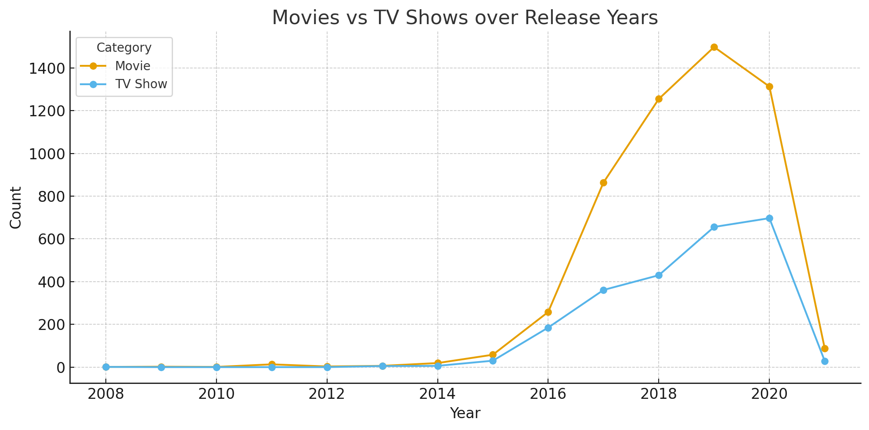
RESULTS1

Slide 8
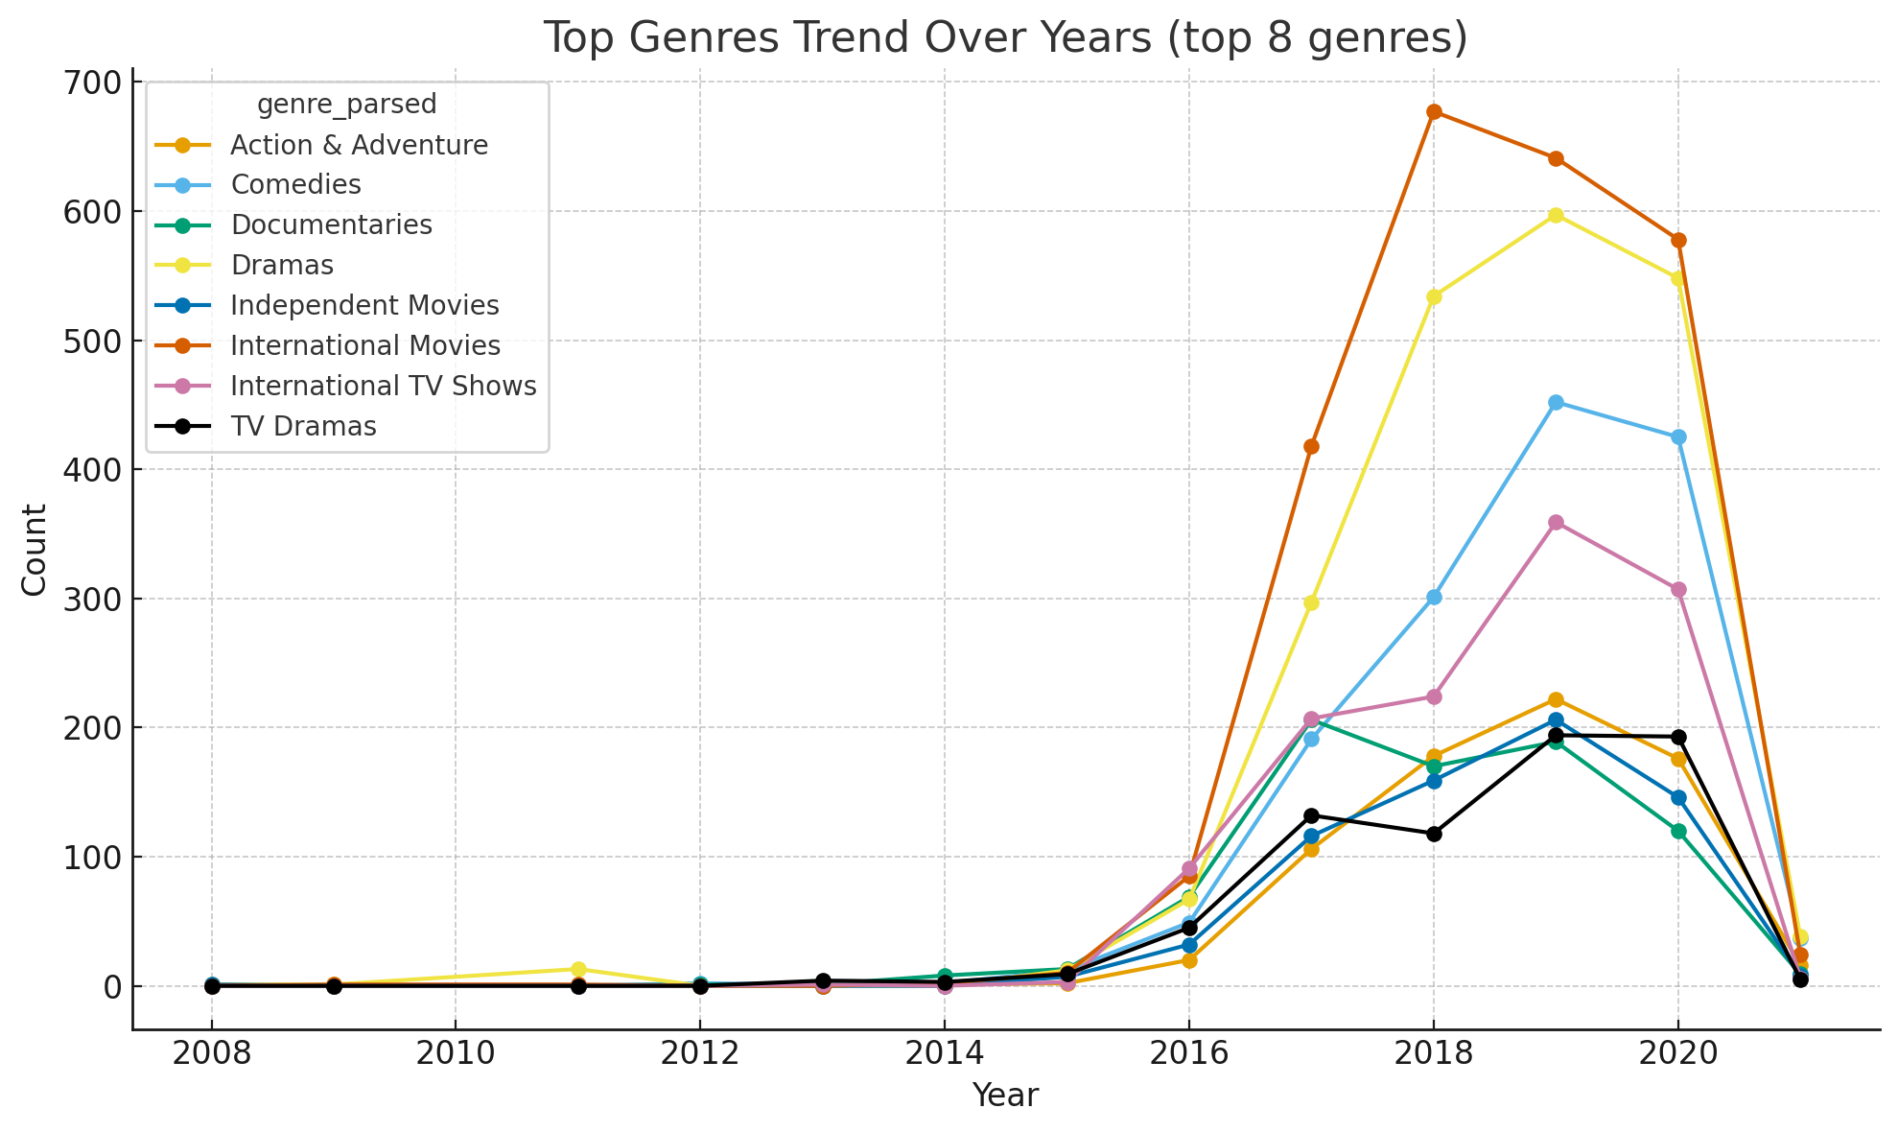
RESULTS2

Slide 9
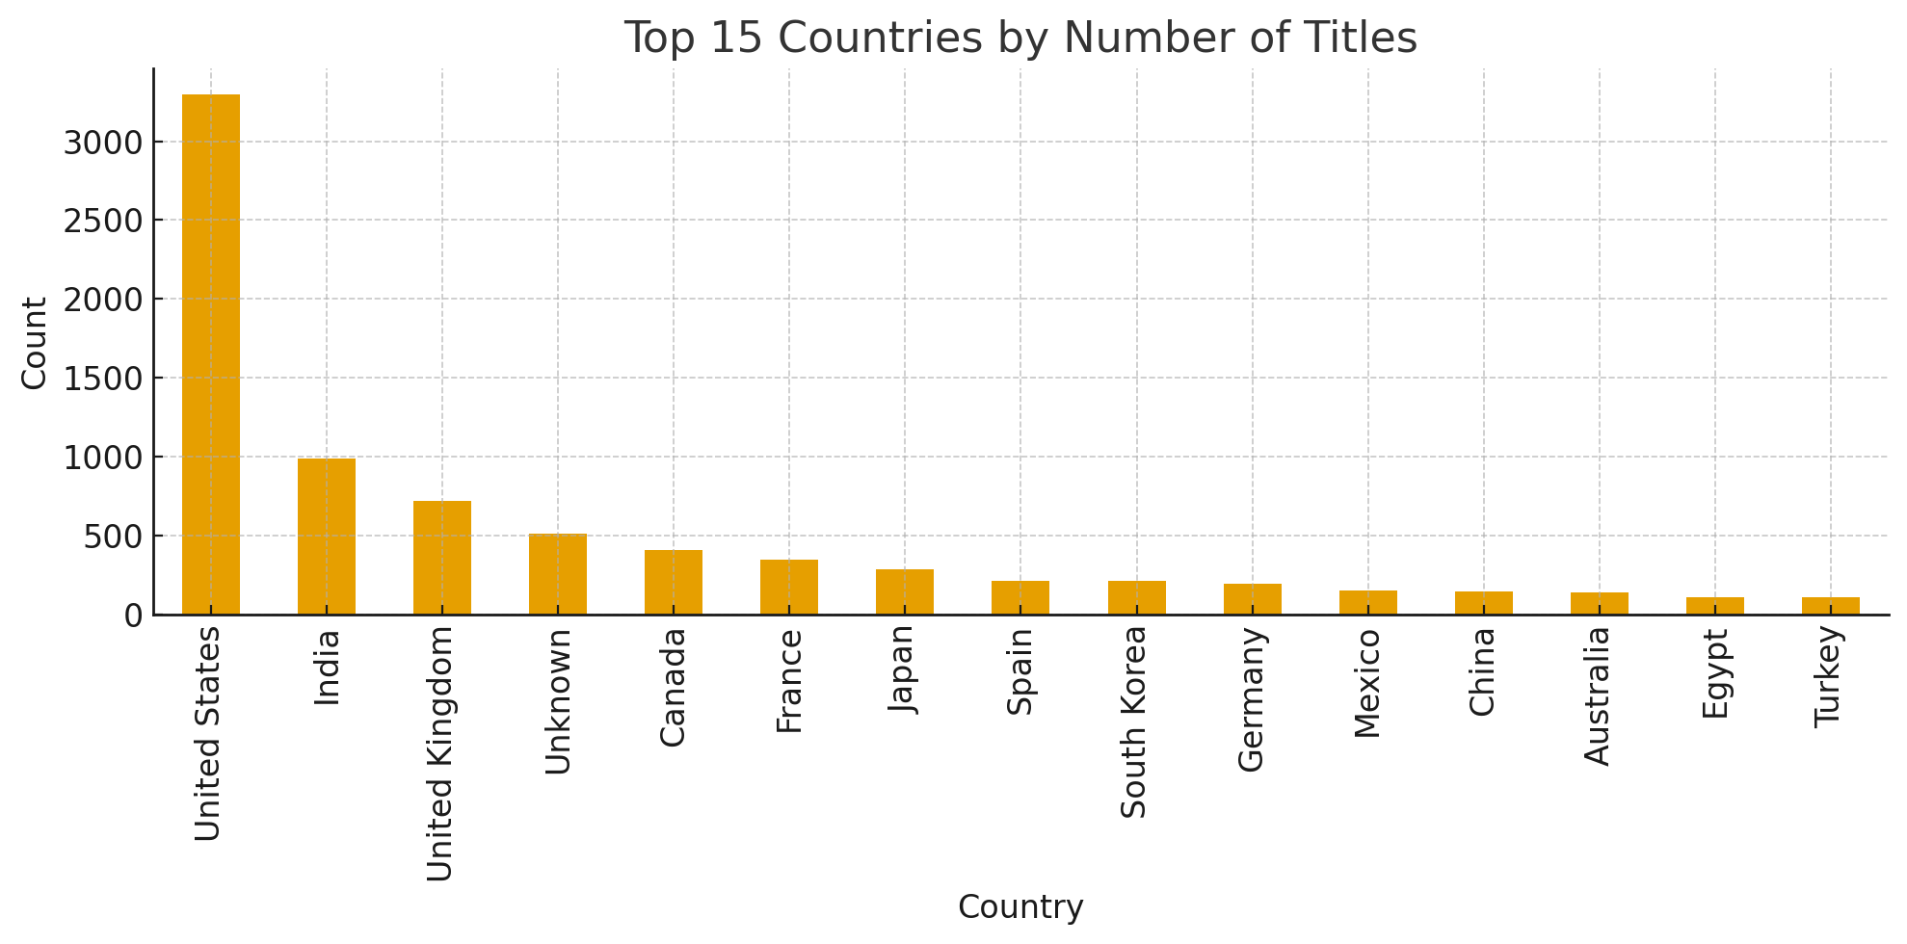
RESULTS3

Slide 10
GitHub repository
https://github.com/Viishhnuvardhunreddy-12/VOIS_AICTE_Oct2025_MajorProject_ViishhnuVardhunReddy

Slide 11

Getting started with Basics of Python Certificate

Slide 12

Data Visualization Certificate

Slide 13
Thank you
.
.

